Slide 1
Chapter 6
Image Segmentation

Slide 2
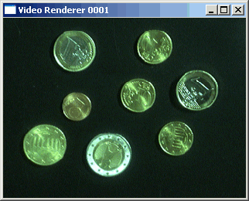
The Segmentation Problem
Segmentation attempts to partition the pixels of an image into groups that strongly correlate with the objects in an image
Typically the first step in any automated computer vision application

Slide 3

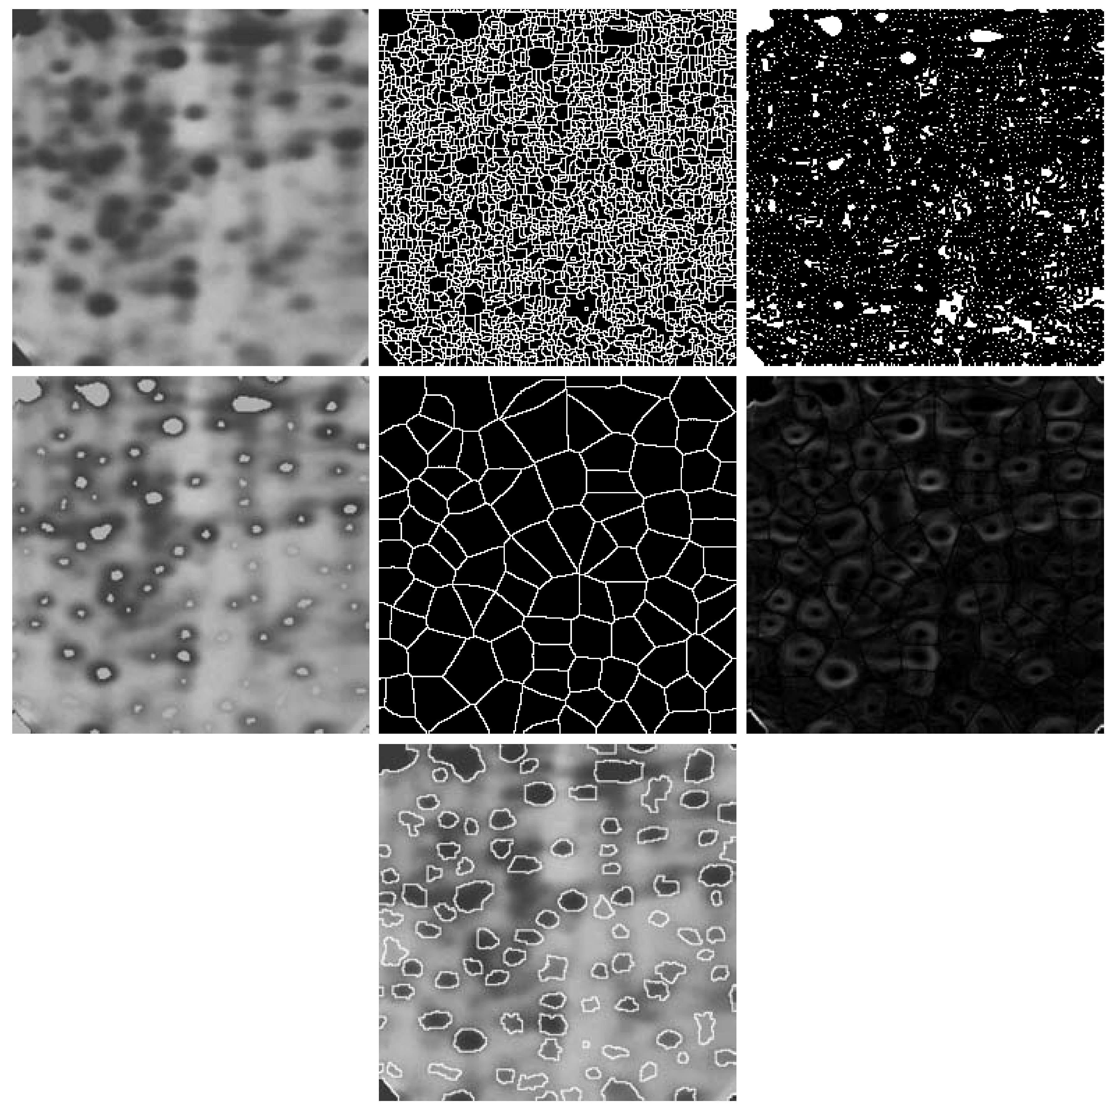
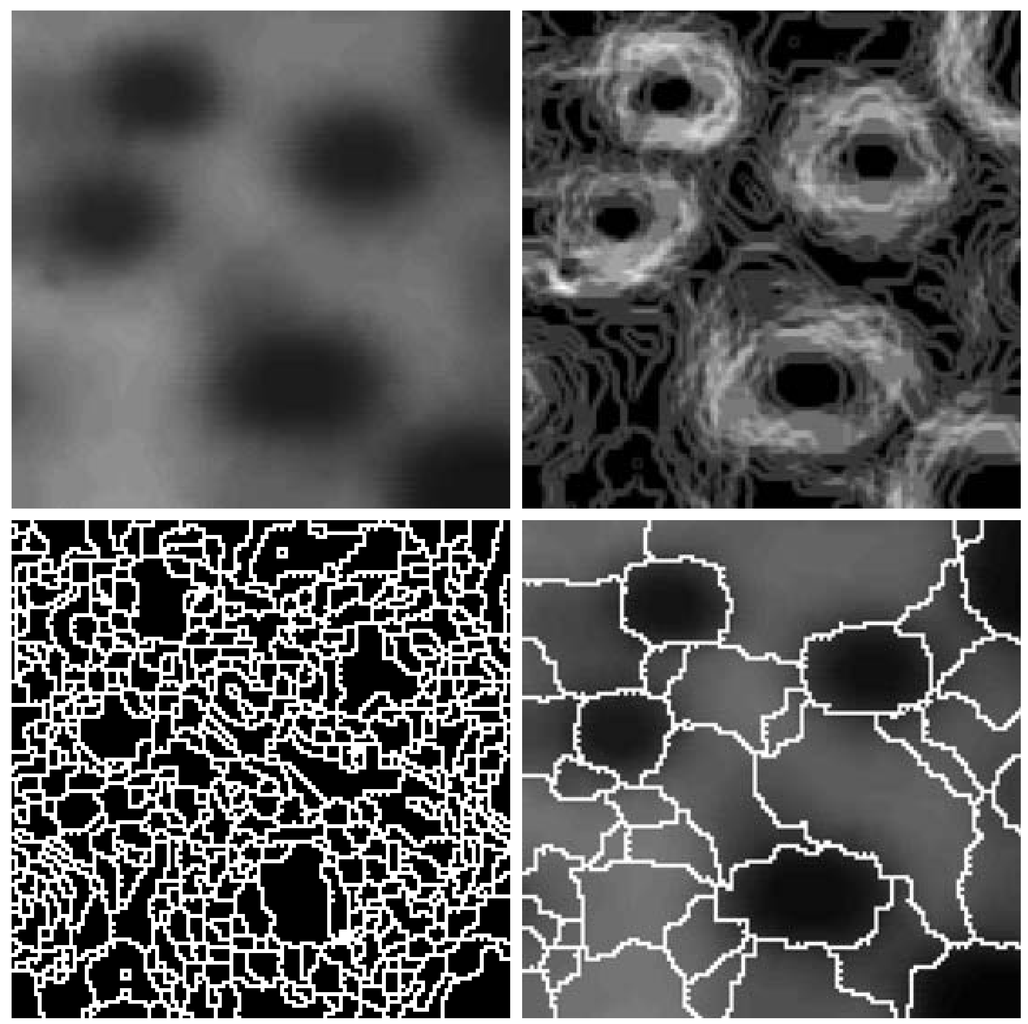
Segmentation Examples
Images taken from Gonzalez & Woods, Digital Image Processing (2002)

Slide 4
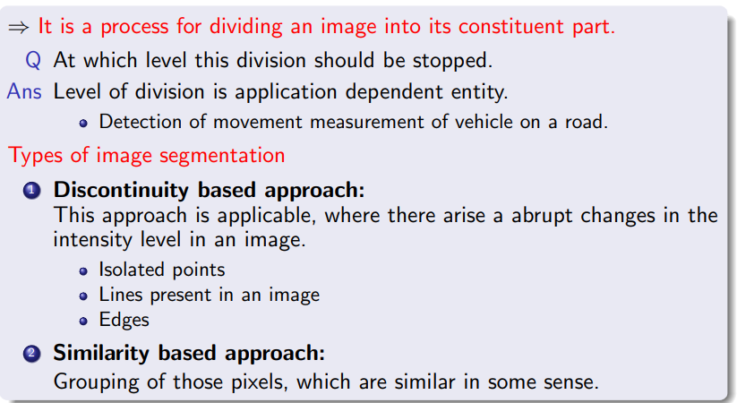
Image Segmentation

Slide 5
Discontinuity Based Approach
There are three basic types of grey level discontinuities that we tend to look for in digital images:
Points
Lines
Edges
We typically find discontinuities using masks and correlation

Slide 6
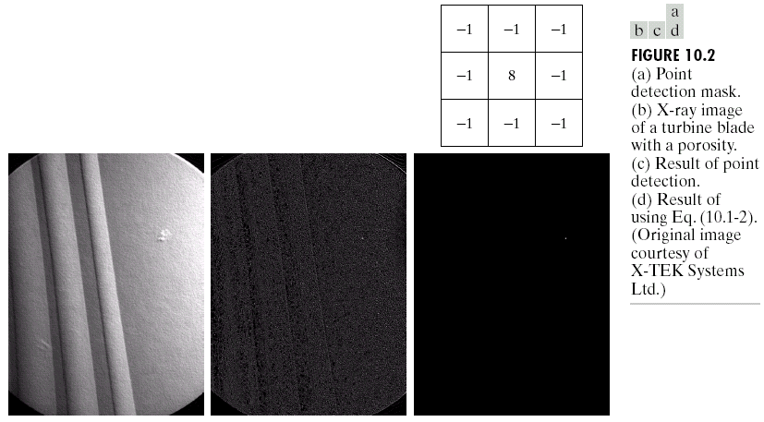
Point Detection
Point detection can be achieved simply using the mask below:
Points are detected at those pixels in the subsequent filtered image that are above a set threshold
Images taken from Gonzalez & Woods, Digital Image Processing (2002)

Slide 7
Point Detection (cont…)
Images taken from Gonzalez & Woods, Digital Image Processing (2002)
X-ray image of a turbine blade
Result of point detection
Result of thresholding

Slide 8
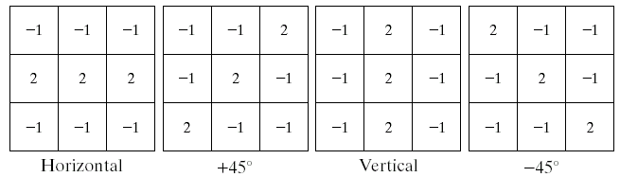
Line Detection
The next level of complexity is to try to detect lines
The masks below will extract lines that are one pixel thick and running in a particular direction
Images taken from Gonzalez & Woods, Digital Image Processing (2002)

Slide 9
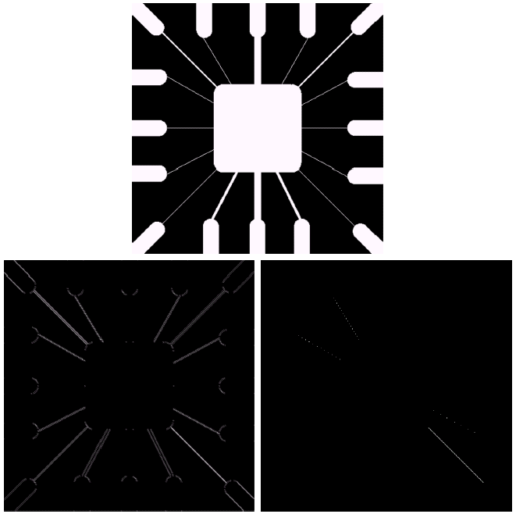
Line Detection (cont…)
Binary image of a wire bond mask
Images taken from Gonzalez & Woods, Digital Image Processing (2002)
After processing with -45° line detector
Result of thresholding filtering result

Slide 10
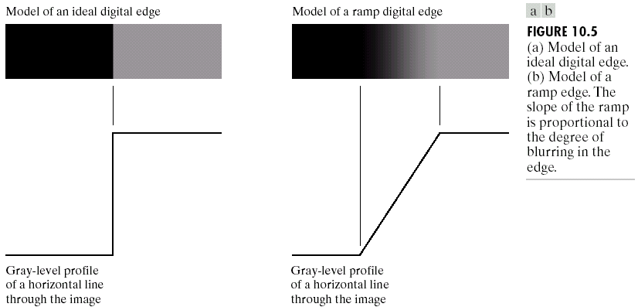
Edge Detection
An edge is a set of connected pixels that lie on the boundary between two regions
Images taken from Gonzalez & Woods, Digital Image Processing (2002)

Slide 11
Edges & Derivatives
1st derivative tells us where an edge is
2nd derivative can be used to show edge direction
Derivative based edge detectors are extremely sensitive to noise
Images taken from Gonzalez & Woods, Digital Image Processing (2002)

Slide 12
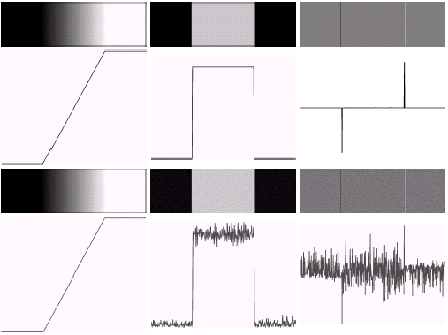
Derivatives & Noise
Images taken from Gonzalez & Woods, Digital Image Processing (2002)

Slide 13
Types of Image Segmentation Techniques
Edge-Based Segmentation
Region-Based Segmentation
Thresholding Segmentation
Watershed Segmentation

Slide 14
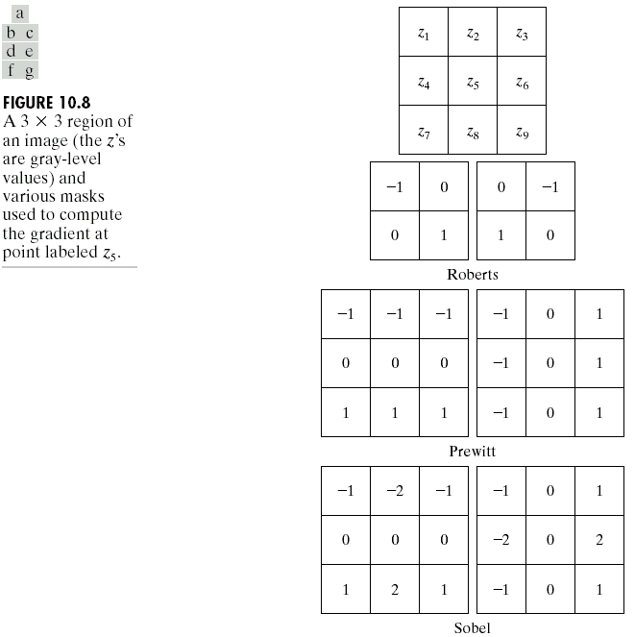
Edge Based Segmentation
Given a 3*3 region of an image the following edge detection filters can be used
Images taken from Gonzalez & Woods, Digital Image Processing (2002)

Slide 15
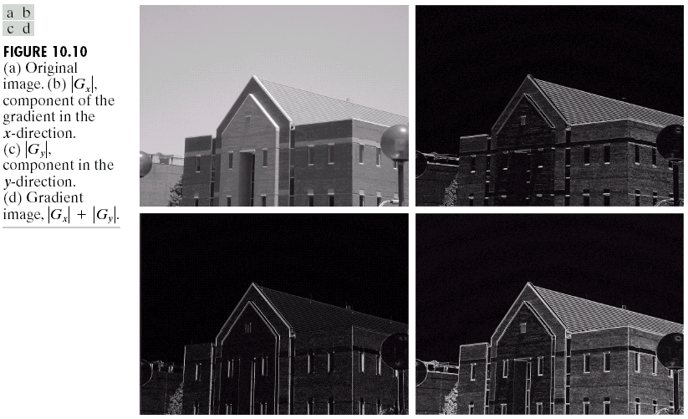
Edge Detection Example
Original Image
Horizontal Gradient Component
Images taken from Gonzalez & Woods, Digital Image Processing (2002)
Vertical Gradient Component
Combined Edge Image

Slide 16
Edge Detection Example
Images taken from Gonzalez & Woods, Digital Image Processing (2002)

Slide 17
Edge Detection Example
Images taken from Gonzalez & Woods, Digital Image Processing (2002)

Slide 18
Edge Detection Example
Images taken from Gonzalez & Woods, Digital Image Processing (2002)

Slide 19
Edge Detection Example
Images taken from Gonzalez & Woods, Digital Image Processing (2002)

Slide 20
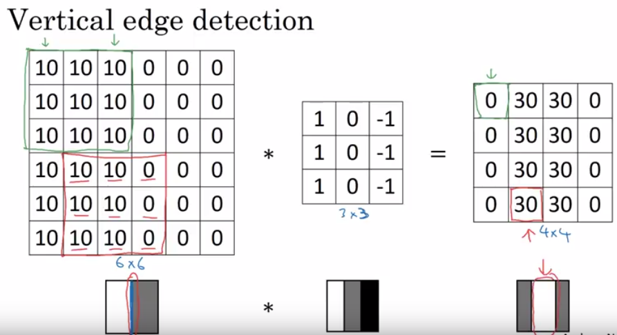
Applying Edge Detectors
Images taken from Gonzalez & Woods, Digital Image Processing (2002)

Slide 21
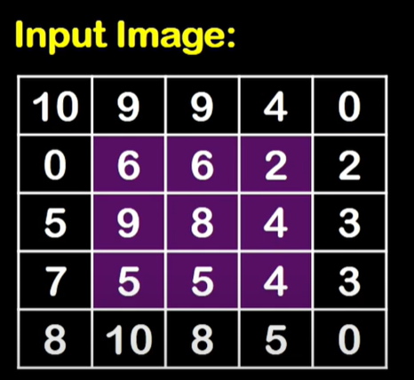
Edge Detection Solved Problems
Perform Edge detection on the given input image by applying Sobel Edge Detector.

Slide 22
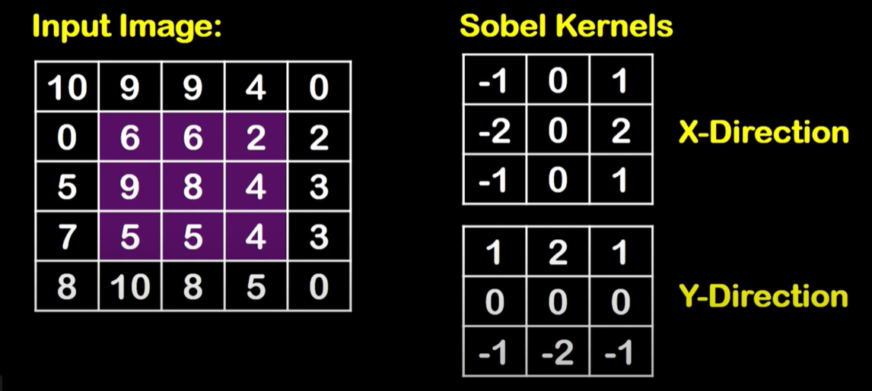
Edge Detection Solved Problems

Slide 23
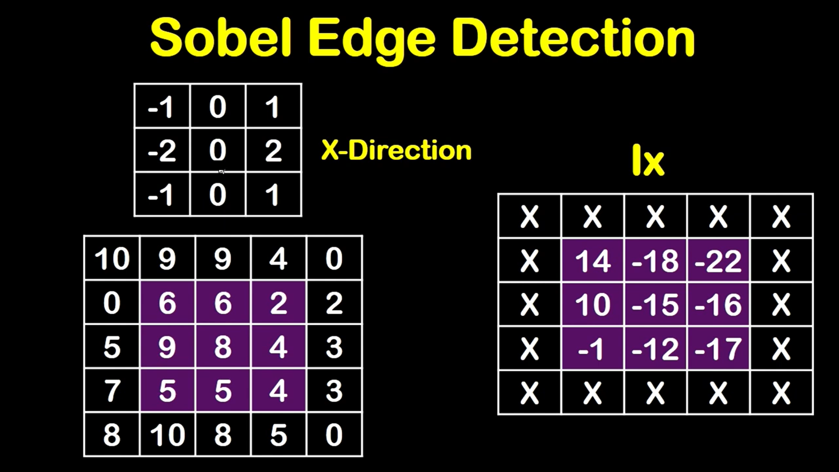
Edge Detection Solved Problems

Slide 24
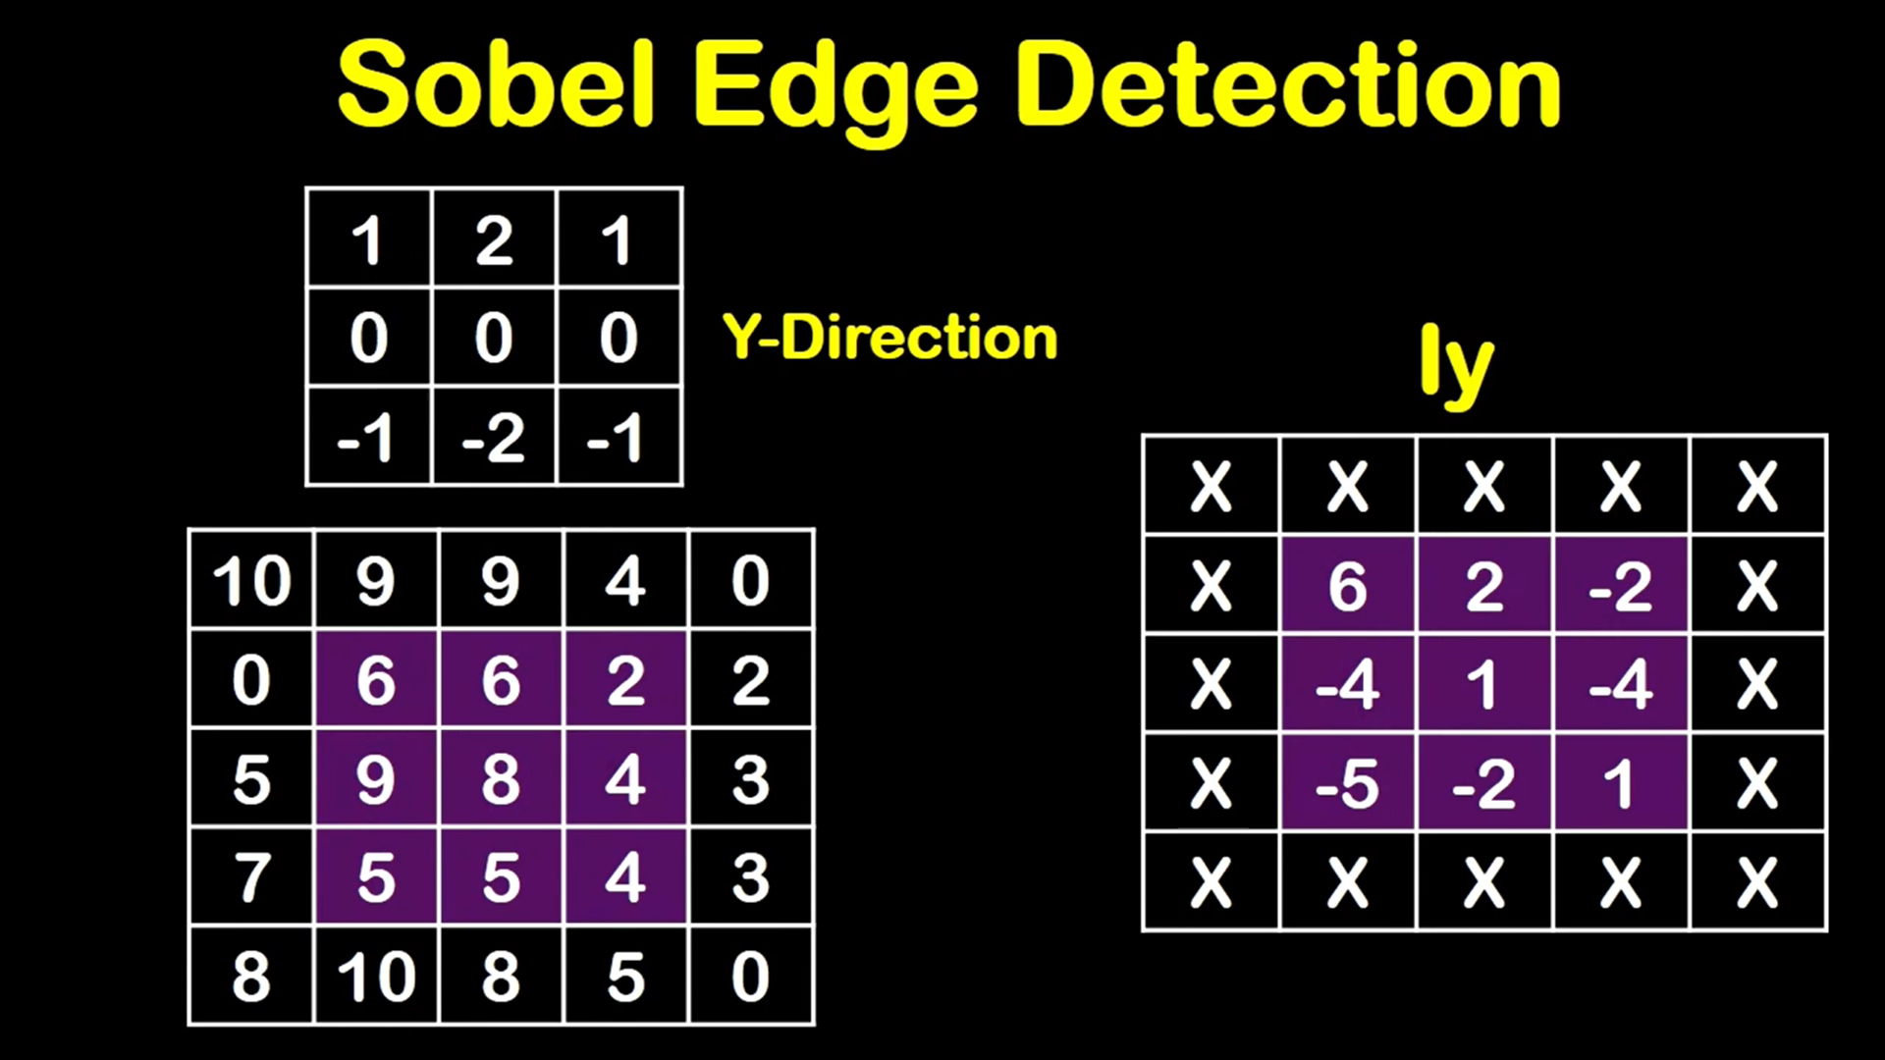
Edge Detection Solved Problems

Slide 25
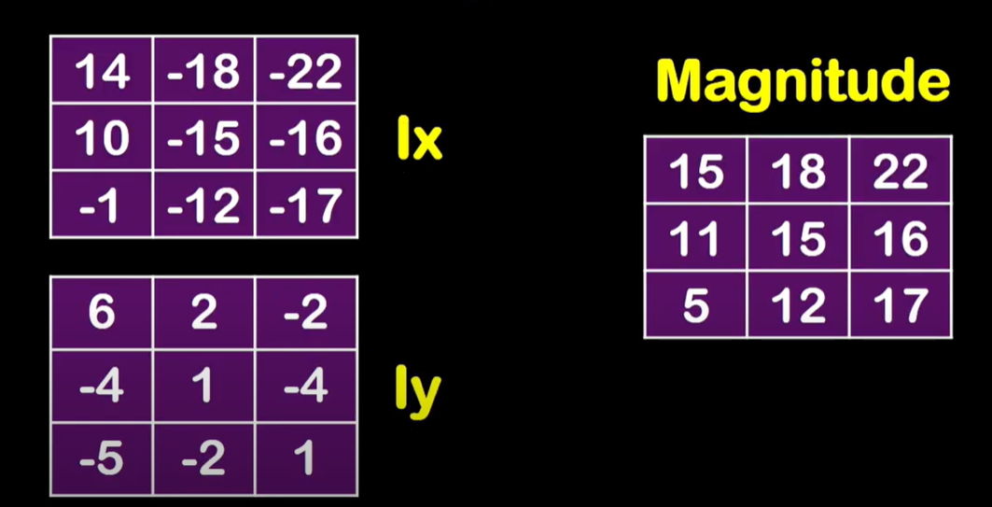
Edge Detection Solved Problems

Slide 26
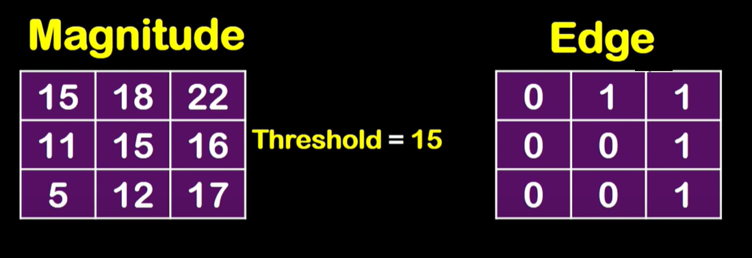
Edge Detection Solved Problems

Slide 27
Edge Detection Solved Problems
Perform Edge detection on the given input image by applying Prewitt Edge Detector.

Slide 28
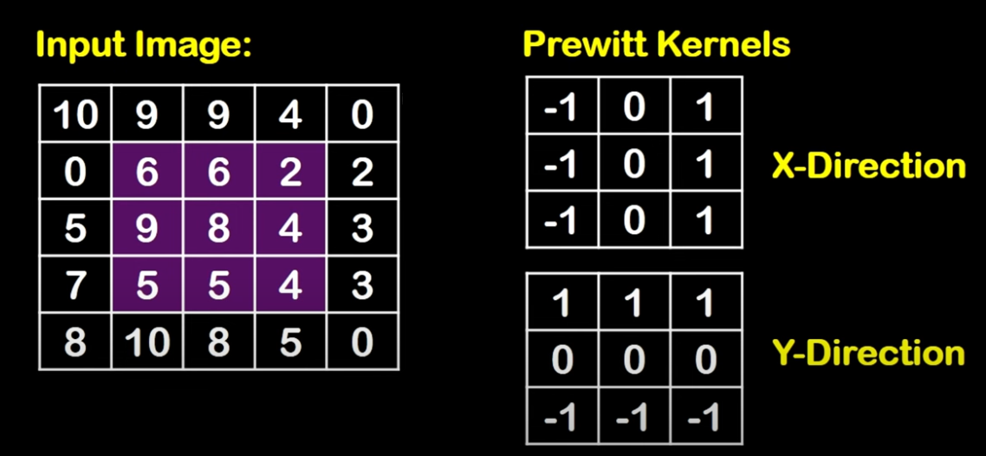
Edge Detection Solved Problems

Slide 29
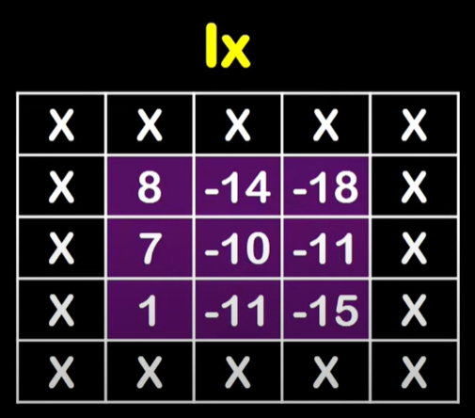
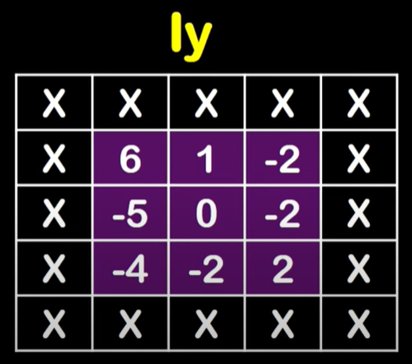
Edge Detection Solved Problems

Slide 30
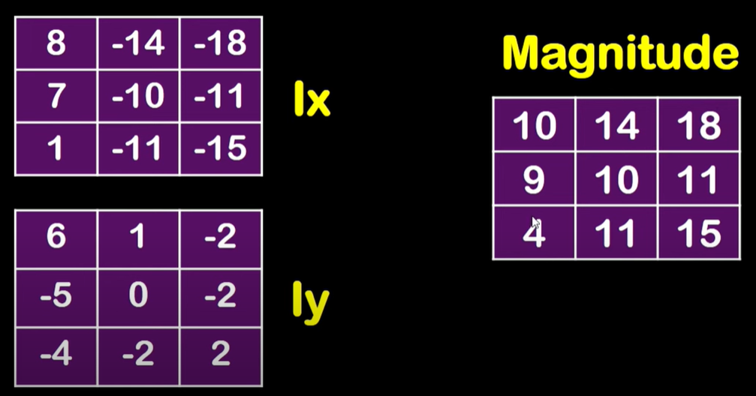
Edge Detection Solved Problems

Slide 31
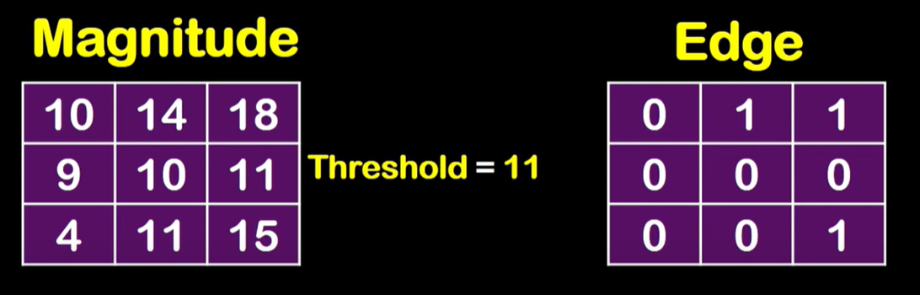
Edge Detection Solved Problems

Slide 32
Edge Detection Problems
Often, problems arise in edge detection is that there are too much detail
For example, the brickwork in the previous example
One way to overcome this is to smooth images prior to edge detection

Slide 33
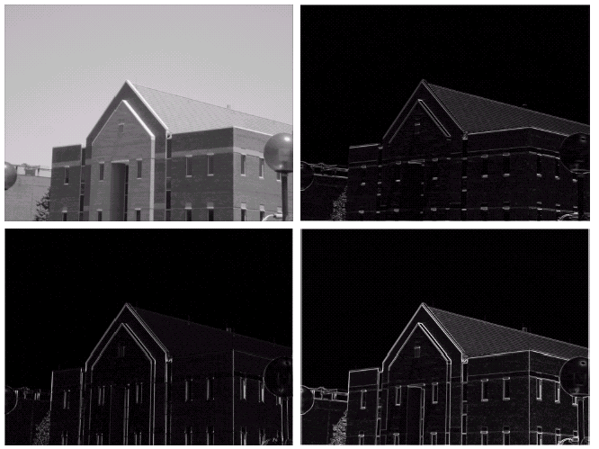
Edge Detection Example With Smoothing
Original Image
Horizontal Gradient Component
Images taken from Gonzalez & Woods, Digital Image Processing (2002)
Vertical Gradient Component
Combined Edge Image

Slide 34
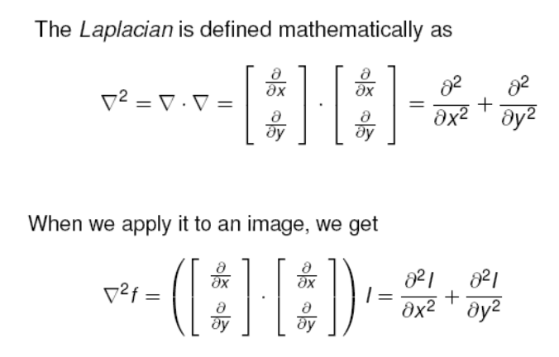
Laplacian Edge Detection ( 2nd Derivative Operator)
Images taken from Gonzalez & Woods, Digital Image Processing (2002)

Slide 35
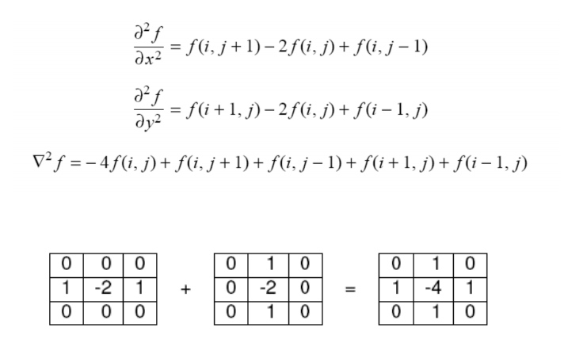
Laplacian Edge Detection
Images taken from Gonzalez & Woods, Digital Image Processing (2002)

Slide 36
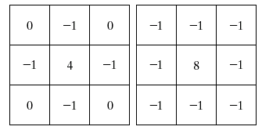
Laplacian Edge Detection
Variations of Laplacians
The Laplacian is typically not used by itself as it is too sensitive to noise
Usually when used for edge detection the Laplacian is combined with a smoothing Gaussian filter
Images taken from Gonzalez & Woods, Digital Image Processing (2002)

Slide 37
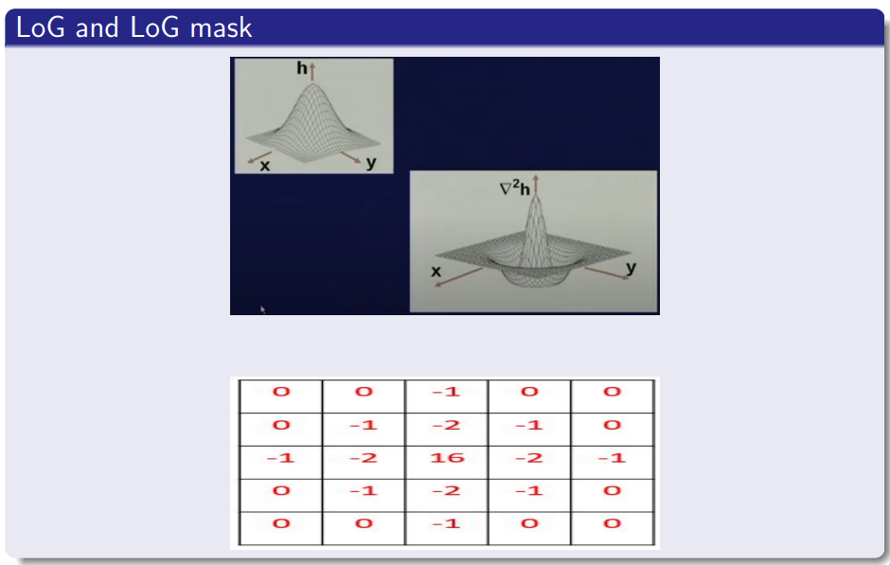
Laplacian of Gaussian Mask
Images taken from Gonzalez & Woods, Digital Image Processing (2002)

Slide 38
Hough Transform
Used for detecting simple geometric shapes like lines, circles, and ellipses in images.
It is especially effective in identifying distorted, incomplete, or partially obscured shapes
Transforms image space into parameter space, enabling the detection of shapes through pattern identification in this transformed space.
Uses a voting mechanism in the parameter space to highlight potential object candidates.
Robust tool in various applications like medical imagery and manufactured part analysis.
While the classical HT focuses on standard curves and is computationally less intensive, the generalized HT caters to more complex shapes where simple analytic descriptions are not feasible.

Slide 39
Hough Transform Working
The Hough transform in image processing works by transforming the image space into a parameter space.
For example, in the case of detecting lines in images, the image space is transformed into a parameter space consisting of two parameters: the slope and the y-intercept of the line.
Each pixel in the image space is then mapped to a curve in the parameter space that represents all the possible lines that could pass through that pixel.
The curves in the parameter space are then analyzed to detect the presence of lines in the image.

Slide 40
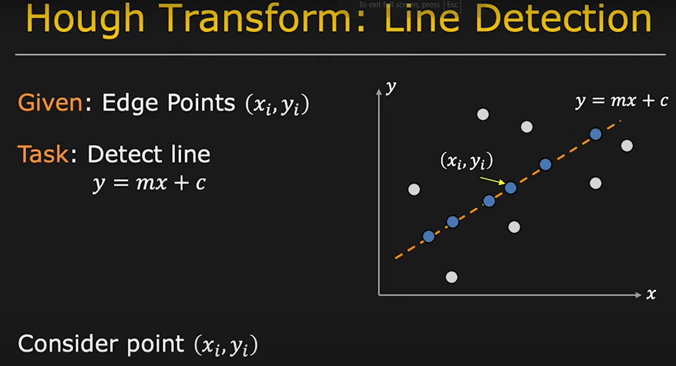
Hough Transform

Slide 41
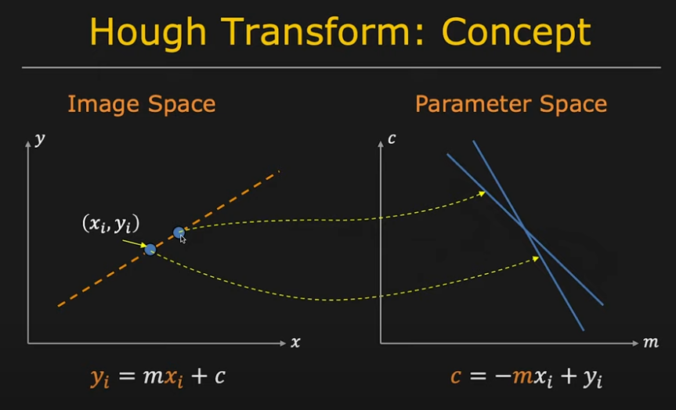
Hough Transform

Slide 42
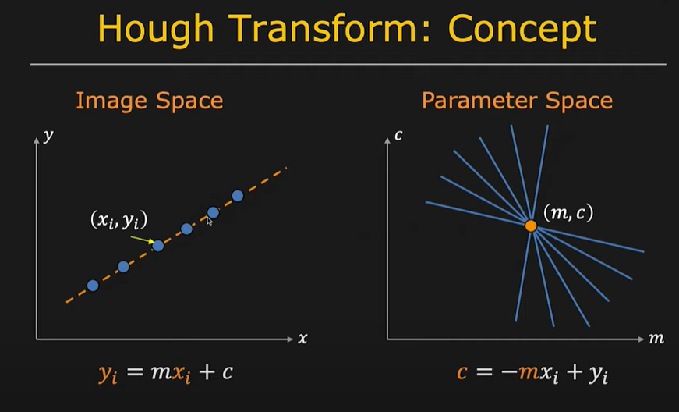
Hough Transform

Slide 43
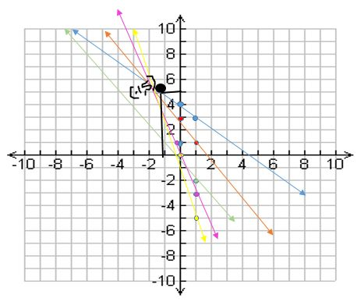
Hough Transform Practice Problem
Given set of points, use Hough transform to join these points. A(1,4), B(2,3) ,C(3,1) ,D(4,1) ,E(5,0)

Slide 44
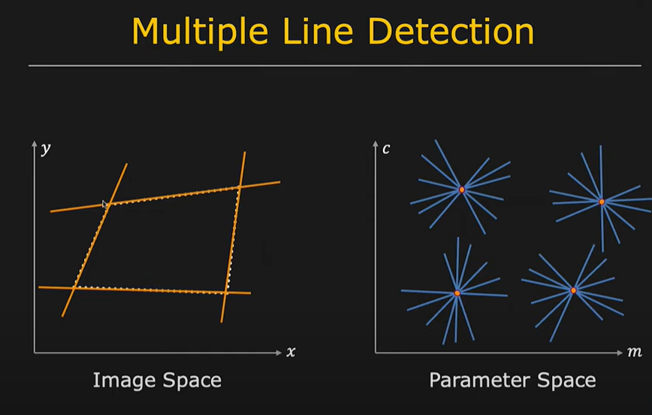
Hough Transform

Slide 45
Region Based Segmentation
Region Growing
Region Splitting and Merging

Slide 46
Region Growing Approach
Region growing breaks down images into distinct areas.
It starts by picking individual pixels (seeds) and then incorporates their neighbors that share similar characteristics, like color or intensity.
This process continues until well-defined regions emerge
Logic behind region growing algorithm is principle of similarity i.e. region is coherent if all pixels of that region are homogeneous.
Similarity of regions is used as the main segmentation criterion in region growing.

Slide 47
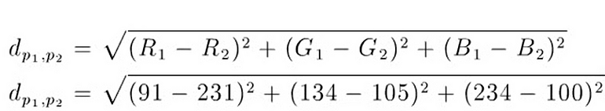
Region Growing Approach
Major steps of region growing algorithm are:
Selection of initial seed
Seed growing criteria
Termination of segmentation process
For example, from one image, select one pixel p1 as an RGB value (91,134,234) and one pixel p2 as an RGB value (231,105,100). Consider euclidean distance as similarity measure.

Slide 48
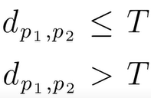
Region Growing Approach
Define a homogeneity threshold (T) between pixels.
If the distance is less than or equal to the threshold, then pixels are homogeneous; if the distance is greater than the threshold value, then pixels are not homogeneous.

Slide 49
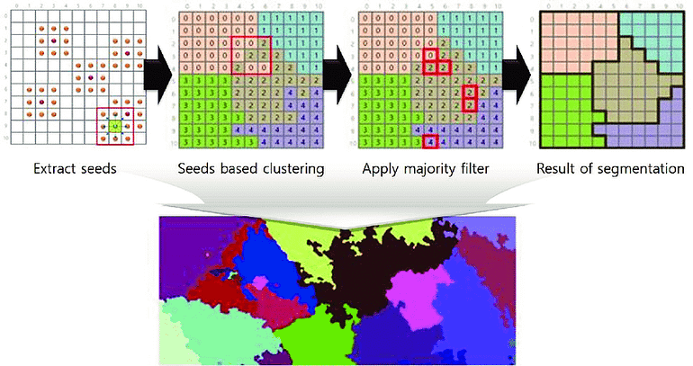
Region Growing Approach

Slide 50
Region Growing Approach
Advantages: - Can accurately divide regions with the same attributes we specify. - Simple concept: we only need a few seed points to symbolize the desired attribute, and then we can expand the region. - We can specify the seed points and criteria we want to use. - Can select many criteria at the same time.
Disadvantages: - Unless a threshold function has been applied to the image, there may be a continuous trail of color-related dots connecting any two points in the image. - Practically random memory access slows down the method, therefore adaptation may be necessary.
Applications:
Object tracking and shape analysis
Medical image analysis: In medical images, the algorithm can segment organs, tumors, or other structures with similar intensity or texture. This helps doctors diagnose diseases.

Slide 51
Region Splitting and Merging Approach
The opposite approach to region growing is region shrinking ( splitting ).
It is a top-down approach and it starts with the assumption that the entire image is homogeneous
If this is not true , the image is split into four sub images
This splitting procedure is repeated recursively until we split the image into homogeneous regions

Slide 52
Region Splitting and Merging Approach
If the original image is square N x N, having dimensions that are powers of 2(N = 2n):
All regions produced but the splitting algorithm are squares having dimensions M x M , where M is a power of 2 as well (M=2m,M<= n).
Since the procedure is recursive, it produces an image representation that can be described by a tree whose nodes have four sons each
Such a tree is called a Quadtree.

Slide 53
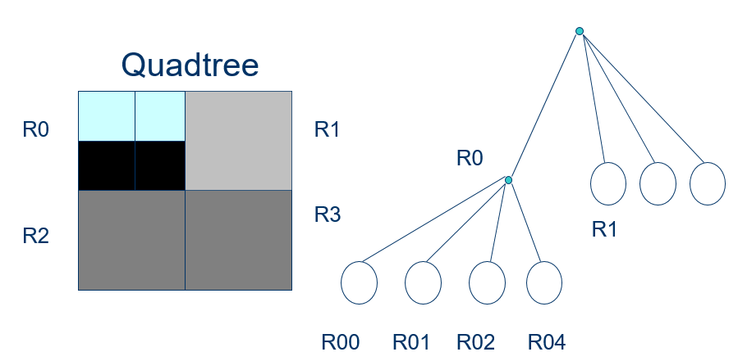
Region Splitting and Merging Approach

Slide 54
Region Splitting and Merging Approach
If a region R is inhomogeneous (P(R)= False) then is split into four sub regions
If two adjacent regions Ri,Rj are homogeneous (P(Ri U Rj) = TRUE), they are merged
The algorithm stops when no further splitting or merging is possible

Slide 55
Thresholding Segmentation
Simplest method for segmentation
It divides the pixels in an image by comparing the pixel’s intensity with threshold.
It is useful when the required object has a higher intensity than the background (unnecessary parts).
Used in medical diagnosis to look for abnormalities, or for noise reduction

Slide 56
Thresholding Segmentation
Simple Thresholding
Replace the image’s pixels with either white or black.
If the intensity of a pixel at a particular position is less than the threshold value, replace it with black.
If it’s higher than the threshold, replace it with white.

Slide 57
Thresholding Segmentation
Otsu’s Binarization/ Otsu’s Method for Image Thresholding
Automatic Thresholding method
It calculates the threshold by maximizing the between-class variance of pixel value, which effectively separates foreground and background regions.
This method is particularly useful when dealing with images that have bimodal or multimodal intensity distributions, as it can accurately identify the threshold that best separates different objects or regions in the image.

Slide 58
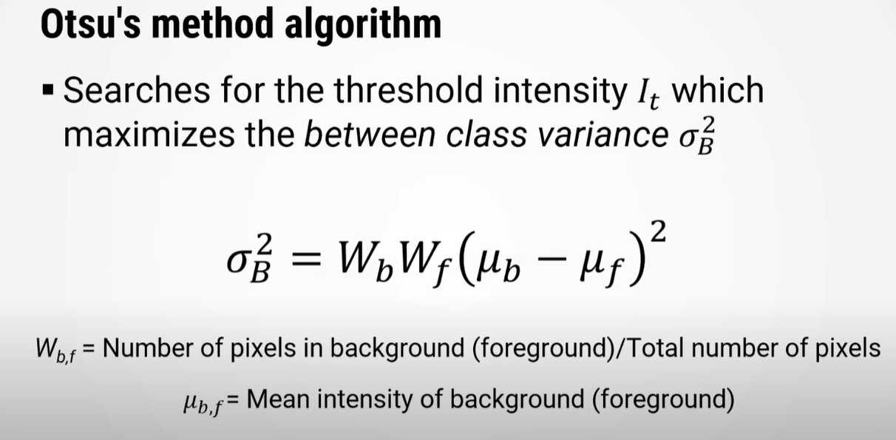

Slide 59
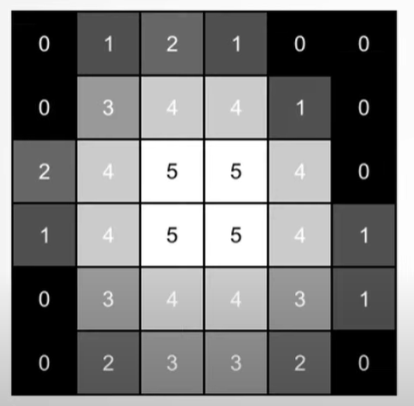
Otsu’s Method Solved Example
Apply image segmentation using Otsu’s method on the given input image

Slide 60
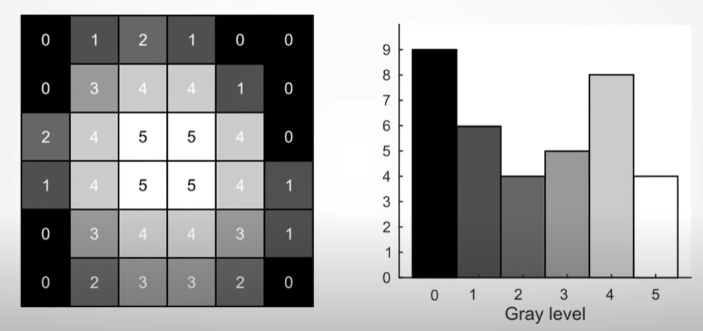
Otsu’s Method Solved Example
Step 1- Compute the Grayscale Histogram

Slide 61
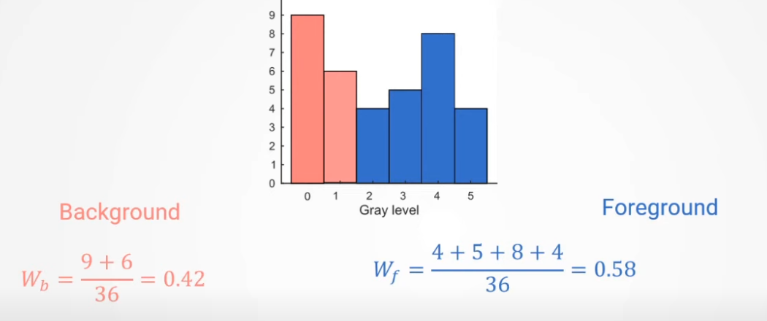
Otsu’s Method Solved Example
Step 2- Compute CDF for foreground and background ( Considering Each gray level as mid point separating foreground and background)
Eg- For gray level 2

Slide 62
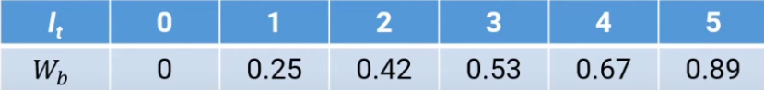
Otsu’s Method Solved Example
Step 2- Compute CDF for foreground and background ( Considering Each gray level as mid point separating foreground and background)

Slide 63

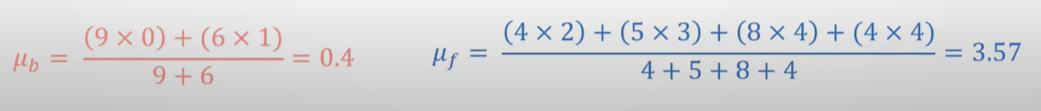
Otsu’s Method Solved Example
Step 3- Compute the Mean Grayscale Intensity Value for foreground and background ( Considering Each gray level as mid point separating foreground and background)
Eg- For gray level 2

Slide 64
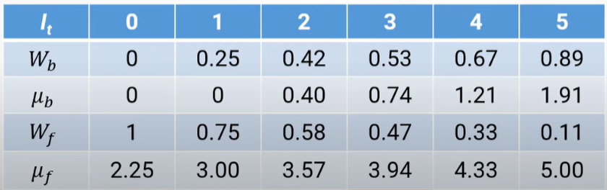
Otsu’s Method Solved Example
Step 3- Compute the Mean Grayscale Intensity Value for foreground and background ( Considering Each gray level as mid point separating foreground and background)

Slide 65
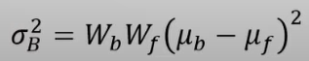
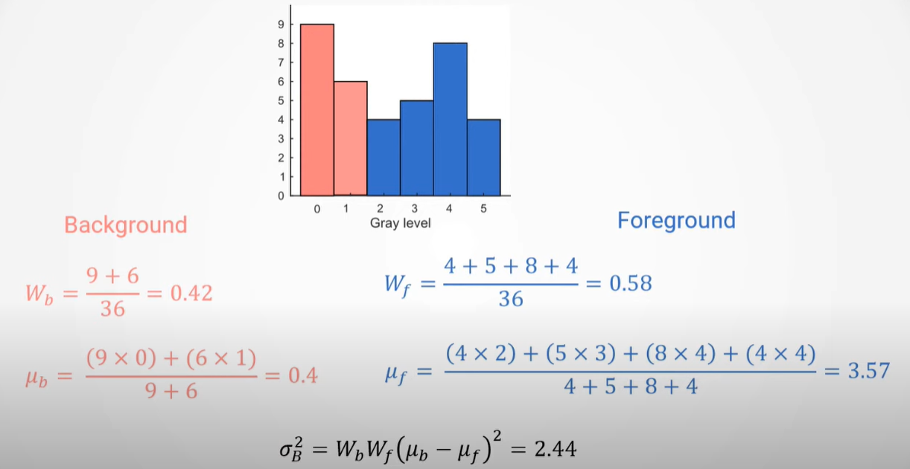
Otsu’s Method Solved Example
Step 4- Compute the Between-Class Variance for Each Possible Threshold Value using the CDF and mean
Eg- For gray level 2

Slide 66
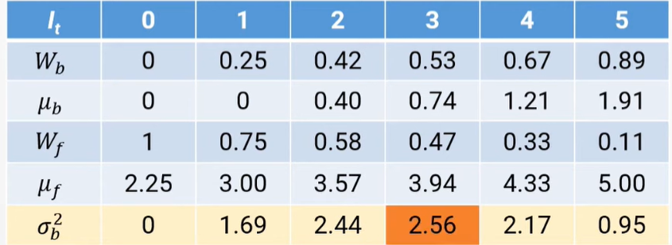
Otsu’s Method Solved Example
Step 4- Compute the Between-Class Variance for Each Possible Threshold Value using the CDF and mean
Highest Between Class- Variance is found for Gray Level 3. Therefore, Set Threshold=3

Slide 67
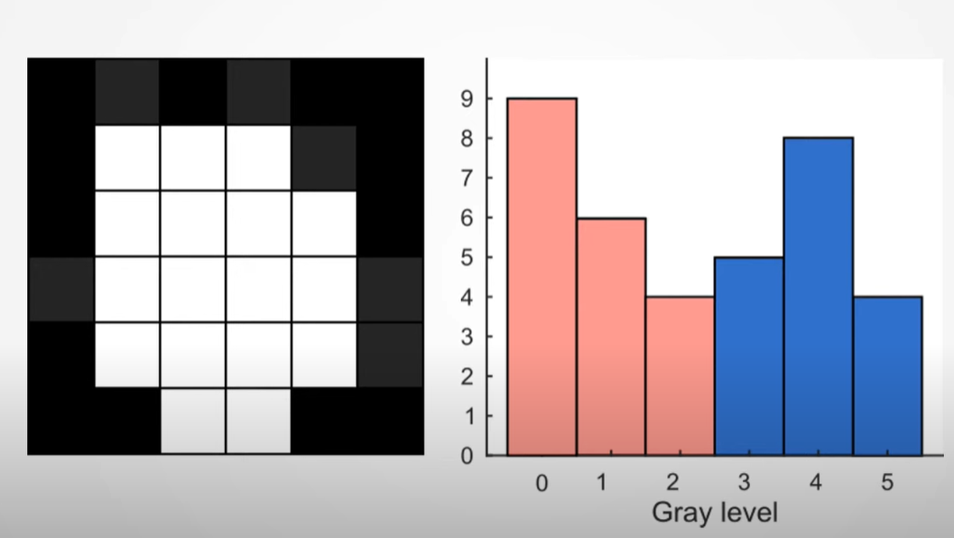
Otsu’s Method Solved Example
Step 5- Set all pixel values < Threshold to 0 and all pixel values >= Threshold to 1.

Slide 68
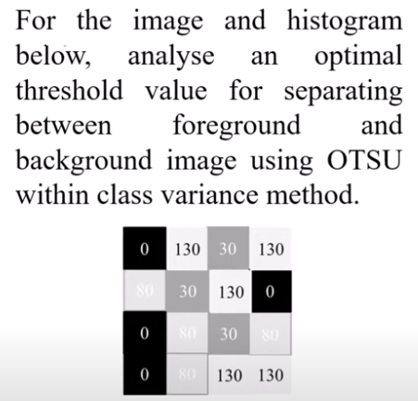
Practice Question

Slide 69
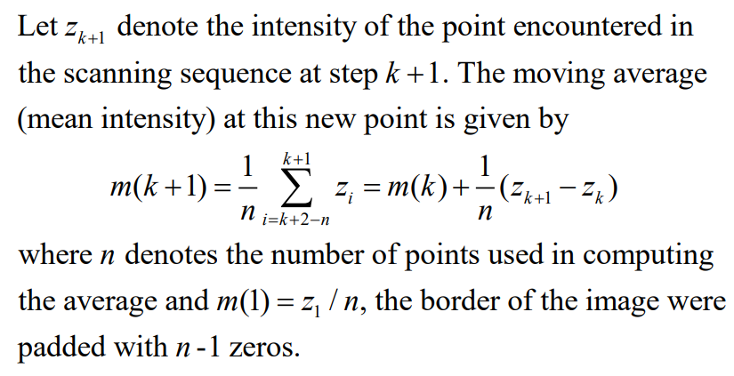
Variable Thresholding Using Moving Averages
Thresholding based on moving averages works well when the objects are small with respect to the image size
Quite useful in document processing
The scanning (moving) typically is carried out line by line in zigzag pattern to reduce illumination bias

Slide 70


Variable Thresholding Using Moving Averages

Slide 71

Variable Thresholding Using Moving Averages

